Slide 1
MISSIONAL LIVING: INTRODUCTION

Slide 2
THE MISSIONAL CALLING

Slide 3
“EVERY CHRISTIAN IS EITHER A MISSIONARY OR AN IMPOSTER.”
Charles H. Spurgeon

Slide 4
“MISSIONS IS NOT THE ULTIMATE GOAL OF THE CHURCH. WORSHIP IS. MISSIONS EXISTS BECAUSE WORSHIP DOESN’T.” John Piper

Slide 5
THE MISSIONAL CALLING
Where does the Christian mission begin?
Gen. 1:26-30; Human beings are intended to be priests and kings.
Sin changed that. Because of the Fall, our mission looks a little differently.
Matt. 28:18-20; Lk. 24:45-48; Jn. 17:18; Acts 1:6-8
Who are these passages addressed to?
1 Pet. 2:4-10.
The New Testament precedent is an every member ministry.

Slide 6
THE MISSIONAL CALLING
Does this mean that every Christian is an evangelist?
No. Every Christian being a participant in the ministry does not mean that every Christian is an evangelist (Eph. 4:7, 11-12; See also 1 Corinthians 12).
Notice there is a two-fold approach to the mission effort:
First, there are those with the gifting of being an evangelist.
Second, every other gifting is to be used with an evangelistic orientation.
Col. 4:2-6

Slide 7
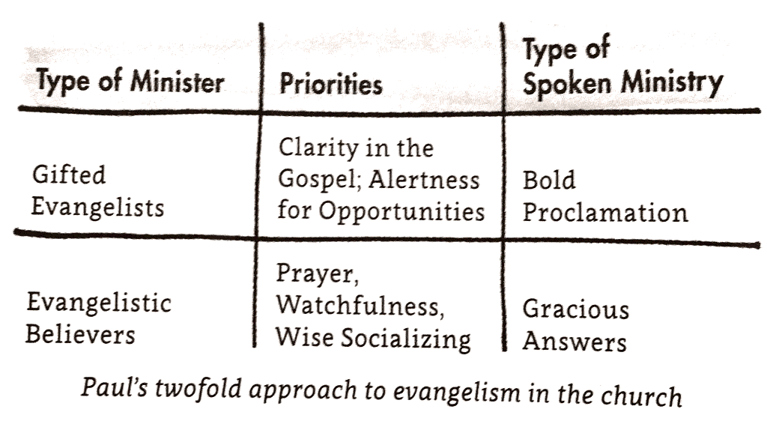

Slide 8
THE MISSIONAL CALLING
“If I don’t have the gifting of apostle or evangelist, then am I obligated to do evangelism?”
If God gives you the opportunity, then yes (1 Pet. 3:15-16).
“Evangelistic mission works effectively when we are living generous, hospitable, Spirit-led, Christlike lives as missionaries to our own neighborhoods—and when the gifted evangelists in our midst join us in sharing Christ with our neighbors.” - Michael Frost
Therefore, whatever your gifting is, you are called to leverage that gifting for the sake of the mission. This is the fundamental mindset of a missionary.

Slide 9
THE MISSIONAL METHOD

Slide 10
THE MISSIONAL METHOD
There is no shortage of evangelism methods (Way of the Master, Roman Road, FAITH, etc.).
I think that these methods can be a helpful way to learn how to articulate the gospel clearly; however, as a method for Christian mission I find them overall weak.
What I believe we need—especially as Christian in the 21st century—is a strategy for mission that goes beyond traditional methods.

Slide 11
THE MISSIONAL METHOD
Weaknesses with traditional methods:
Individualistic
Too static
Often comes off as aggressive or impersonal
If you aren’t eloquent or persuasive then good luck
Hard to integrate apologetics when needed
Doesn’t incorporate the rest of life
Have you ever had someone try to witness to you like this?

Slide 12
THE MISSIONAL METHOD
Rebecca Manly Pippert said, “Christians and non-Christians have something in common. We’re both uptight about evangelism.”
Traditional evangelism methods often treat non-Christians as evangelism projects instead of persons.
In Get Real, John Leonard told two stories about being witnessed to, Bob and Fred.
He understandably wasn’t interested in seeing Bob again, but he wanted to get to know Fred more.
What’s our solution?

Slide 13
THE MISSIONAL METHOD
Real evangelism.
Real evangelism is an approach to mission that goes beyond the salesman-style techniques of traditional evangelism. Real evangelism is a whole set of habits, an entire lifestyle of missionary living.
We are going to go beyond the memorized scripts to adopting a mission that seeks to engage with people and build deep, spiritual relationships.
“A real approach is not a presentation that you memorize, because the gospel you share is shaped by the person the Lord has brought into your life. It is molded by that person’s particular circumstances, problems, and struggles. In this approach to evangelism, the gospel is not a one-size-fits-all spandex sweatsuit; it is tailor-made, fitting only one person— the one standing in front of you.” - Leonard

Slide 14
THE MISSIONAL MODEL

Slide 15
THE MISSIONAL MODEL
Our model for doing real evangelism is Jesus and the New Testament church.
We’re often afraid to engage with the mission for a number of reasons.
Awkwardness, don’t want to offend, don’t know what to say…
But we need to remember this: God’s chosen method of spreading his good news in the world is human beings just like you.
A real approach to evangelism takes care of these fears, because we are allowed to be ourselves and be normal.

Slide 16
THE MISSIONAL MODEL
Jesus is our primary model. His bold, yet compassionate, engagement with people is our goal.
If God chose to use humans as the vehicle for his mission, then we should endeavor to look like the pinnacle of humanity—Jesus.
First of all, God sent a man to save the world.
“His strategy hasn’t changed. He still sends men and women—before he sends tracts and techniques—to change the world. You may think his strategy is risky, but that is God’s problem, not yours.” - Pippert

Slide 17
THE MISSIONAL MODEL
““[GOD] MADE US HUMAN. HE IS THEREFORE INTERESTED IN EVERY ASPECT OF OUR HUMANNESS. IT IS THE STUFF OF OUR HUMANITY—THE EVERYDAY GRIT AND GLORY THAT WE ALL ENCOUNTER SIMPLY BY WALKING OUT THE DOOR EACH MORNING—THAT GOD USES TO SHAPE A HOLY LIFE WITHIN US.”
REBECCA MANLY PIPPERT

Slide 18
THE MISSIONAL MODEL
Second, we should do evangelism as Jesus did.
Jesus built relationships and invested his time into people. He socialized with those who needed to hear his message. His was gentle and bold.
Jesus engages with each person as he or she is. He meets them where they are and communicates with them appropriately.
Third, we should model our mission after the NT church.
As Michael Frost says, we should live “questionable lives” (1 Pet. 3:15-16).

Slide 19
“WE MUST PAY SPECIAL ATTENTION TO THIS POINT, AND BY THIS MEANS EFFECT A CURE. FOR WHEN IT CAME ABOUT THAT THE POOR WERE NEGLECTED BY THE [PAGAN] PRIESTS, THEN I THINK THE IMPIOUS GALILEANS OBSERVED THIS FACT AND THEY DEVOTED THEMSELVES TO PHILANTHROPY. AND THEY HAVE GAINED ASCENDANCY IN THE WORST OF THEIR DEEDS THROUGH THE CREDIT THEY WIN FOR SUCH PRACTICES… FOR JUST AS THOSE WHO ENTICE CHILDREN WITH A CAKE… BY THE SAME METHOD, I SAY, THE GALILEANS ALSO BEGIN WITH THEIR SO-CALLED LOVE-FEAST, OR HOSPITALITY, OR SERVICE OF TABLES—FOR THEY HAVE MANY WAYS OF CARRYING IT OUT AND HENCE CALL IT BY MANY NAMES—AND THE RESULT IS THAT THEY HAVE LED VERY MANY INTO ATHEISM.”
JULIAN (331-363)

Slide 20
THE MISSIONAL MODEL
So, how do we live “questionable” lives? With a new set of missionary habits:
Upward habits that bring us into deeper intimacy with Jesus.
Inward habits that move us toward an intentional Christian community.
Outward habits that welcomes our neighbors in.

Slide 21
THE MISSIONAL HABITS

Slide 22
THE MISSIONAL HABITS
Our goal for the class is develop a way of life that is mission focused. So, we need regular habits that transform our everyday life.
Habits are much more powerful than what we give them credit for. The ancient Greeks understood that virtue is formed by habit.
“We are what we repeatedly do. Excellence, then, is not an act, but a habit.” Aristotle
As missionaries, there is a strong link between our inner spiritual life and outward actions and habits.

Slide 23
THE MISSIONAL HABITS
French philosopher Pierre Bourdieu called this principle habitus. He is referring to a societies rhythms and habits, which give shape to the values of that society.
We need a personal habitus in our lives. Missional habits that develop a missional character and values.
The set of habits that we are about to learn is called BELLS—bless, eat, listen, learn, and sent.

Slide 24
THE MISSIONAL HABITS
BLESS: I will bless three people this week, at least one of whom is not a member of our church.
EAT: I will eat with three people this week, at least one of whom is not a member of our church.
LISTEN: I will spend at least one period of the week listening for the Spirit’s voice.
LEARN: I will spend at least one period of the week learning Christ.
SENT: I will journal throughout the week about all the ways I alerted others to the universal reign of God through Christ.

Slide 25
THE MISSIONAL HABITS
If you can implement BELLS into your life, then here’s what will happen.
BLESS will make you a generous person.
EAT will make you a hospitable person.
LISTEN will make you a Spirit-led person.
LEARN will make you a Christlike person.
SENT will make you a missionary.

Slide 26
THE MISSIONAL HABITS
Here’s a few tips for you as you begin this week:
Make these mindful habits and be intentional.
When you work on a habit, be sure to do it as an expression of your gifting.
Remember that these are MISSIONAL habits!
Develop these habits in Christian community for 1) accountability and 2) so that missional living also deepens your Christian discipleship as well.

