Slide 1
MISSIONAL LIVING:
BLESS & EAT

Slide 2
INTRODUCTION
Remember that our goal for this class is to develop a missionary lifestyle, not learn a method or presentation.
  Since we want to live a missionary lifestyle we must develop the character and habits of a missionary.
At the end of our last class we briefly introduced the BELLS missional habits. Today we will cover the first two in depth.

Slide 3
BLESS
I will bless 3 people this week, 1 of whom is not a member of my church

Slide 4
BLESS
Your goal should be to bless at least three people. At least one should be a member of our church. And at least one should be a non-Christian.
What does it mean to bless?
  There’s a variety of definitions. But ‘to bless’ typically means to add value to someone’s life through either positive giving or relieving of a negative burden.

Slide 5
BLESS
Let’s look at three ways that you can bless someone:
First, through words of affirmation.
  “Words of affirmation” is a broad term for any speech that is encouraging or consoling.
  Michael Frost recommends, “Send them a note, write them an e-mail, or text them. Send them some words of affirmation and encouragement. Let them know you’ve noticed something worthwhile about them.”
Notes:
Mark Twain: “I can live for two months on a good compliment.”

Slide 6
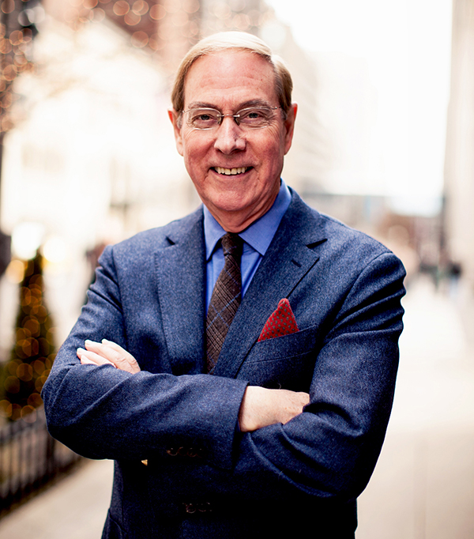
“Encouragement requires empathy and seeing the world from [another’s] perspective. we must first learn what is important to [the other]. Only then can we give encouragement. With verbal encouragement, we are trying to communicate, ‘I know. I care. I am with you. How can I help?’ We are trying to show that we believe in [the person] and in [his or her] abilities. We are giving credit and praise.”
-Gary Champman, The Five Love Languages

Slide 7
BLESS
Second, through acts of kindness.
  Do something that lightens someone’s load.
Third, through giving gifts.
  Don’t give them just anything. Give them something that communicates thoughtfulness and love. Give them something that shows them that they are known, cared for, and valued.
Missionaries who take the initial step of blessing and then share the gospel have been found to be more effective than those who do not begin with blessing.
Notes:
Doing an act of kindness will help strengthen your bond with someone.
You can do gifts for special occasions, but you should also do completely random gifts.
Missionaries in Thailand: blessers vs. converters: blessers had almost 50 times as many converts.

Slide 8
BLESS
A few cautions about blessing:
First, don’t be generous merely so that you will get a chance to convert the person.
  Sharing the gospel is the hoped-for goal. But you should be willing to bless someone for the sake of the blessing itself.
  Remember Julian’s complaint against the “impious Galileans”?
  They were living a lifestyle. It was habitual.

Slide 9
BLESS
Second, remember that a good blessing causes the recipient to feel blessed.
  The person should not feel manipulated or used by the blessing (Phil. 2:3-4).
  “When the missionaries arrived, the Africans had the land and the missionaries had the Bible. They taught us how to pray with our eyes closed. When we opened them, they had the land and we had the Bible.” Jomo Kenyatta. Don’t be a colonizer!
Notes:
-Blessers should become students of those whom they bless.

Slide 10
BLESS
Lastly, be prepared for people to misunderstand and assume the worst about you.
  Even the best blessings and the purest motivations will not stop people from misunderstanding us or hating us for our faith.
  “…But do this with gentleness and respect, keeping a clear conscious, so that those who speak maliciously against your good behavior in Christ may be ashamed of their slander.” 1 Pet. 3:15-16
  So keep a clear conscious. If you are reviled for your faith, humility, and love, then so be it. But if you’re being a jerk, then that’s on you.

Slide 11
EAT
I will eat with 3 people this week, 1 of whom is not a member of my church.

Slide 12
EAT
Let’s begin with the importance of eating in Christianity…
Nearly every mention of Christianity in ancient literature says something about their feasts and dinners.
  We also know this from the New Testament (Acts 2:42, 46; 1 Cor. 11:17-22).
Eating together has been a central practice of Christianity since its very beginning.
  More than just a social practice, it is a spiritual and even theological practice.
Notes:
Remember Julian again, what was he mad about? Their hospitality!
Pliny the Younger also mentions it in 112AD

Slide 13
“Hospitality, as the mutual indwelling one with another, becomes the modus operandi of mission as those in common participation in the life and mission of god meet and receive from each other… Hospitality is an attitude of the heart which is about openness to the other… This mirrors the hospitality of the trinity as God chooses to open himself to the other through the incarnation and to subject himself to the created order… It is about a generous acknowledgement and meeting of common humanity, emotional, spiritual and physical, with generosity. As such it mirrors the activity of God towards creation.”
-Janice Price, Church of England World Mission Panel

Slide 14
EAT
Tim Chester asked this question, “How would you complete the following sentence:
‘The Son of Man came…’?”

Slide 15
EAT
“The Son of Man came not to be served but to serve, and to give his life as a ransom for many” (Mk. 10:45).
“The Son of Man came to seek and save the lost” (Lk. 19:10).
“The Son of Man has come eating and drinking…” (Lk. 7:34).

Slide 16
EAT
Jesus’ eating habits caused him to be accused of being a “drunkard” and a “glutton.” Obviously, these are false accusations, but Jesus’ company gave the Pharisees plenty of ammunition.
  He did not choose to eat with the upper echelon of Jewish society…
“The table ought to be the primary symbol of the Christian gathering. It represents hospitality, inclusivity, generosity, and grace.” Michael Frost

Slide 17
“The act of Jesus was to reverse this structure: communion first, conversion second. His table fellowship with sinners implied no acquiescence in their sins, for the gratuity of the reign of God cancelled none of its demands. But in a world in which sinners stood ineluctably condemned, Jesus’ openness to them was irresistible. Contact triggered repentance; conversion flowered from communion. In the tense little world of ancient Palestine, where religious meanings were the warp and woof of the social order, this was a potent phenomenon.”
- Ben Meyer, The Aims of Jesus

Slide 18
EAT
Belong Before Belief
  This principle says that we bring people into our lives, seeking for them to belong before expecting them to believe.
  We cannot expect to understand others until we are part of their lives, and we cannot expect others to understand us until they are part of our lives.

Slide 19
“Sharing meals together on a regular basis is one of the most sacred practices we can engage in as believers. Missional hospitality is a tremendous opportunity to extend the kingdom of God…. If every Christian household regularly invited a stranger or a poor person into their home once a week, we would literally change the world by eating!”
Alan Hirsch and Lance Ford, “Right Here, Right Now”

Slide 20
EAT
A couple of pointers:
First, challenge yourself by eating with people who are very different from you.
  Anyone can share meals with their friends…
Second, remember that hospitality is a powerful tool to share the gospel.
Third, remind yourself that hospitality is not about impressing your guest.
Fourth, if you can’t do a meal then share a cup of coffee.
Notes:
Read 1 Corinthians 11:23-28
Paul believes that observing the habit of remembering the sacrifice of Christ every time they eat will countermand the impulse to exclude the poor or the outsider.
He is asking them to examine themselves to consider whom they’ve excluded from fellowship.
Example of Baptist pastor and margarita-poker night.

Slide 21
QUESTIONS?

